Slide 1

The Federated Global Sovereign Monetary Authority and International Development Facility
Frans C. Verhagen, M.Div., M.I.A., Ph.D.,
sustainability sociologist of international development
International Institute for Monetary Transformation (IIMT)
www.timun.net; gaia1@rcn.com

Slide 2

Overview
The need for a global governance system perspective on monetary reform and transformation (MRT)and international development
The Global Fed: what, why, how
The International Development Facility
Global 24 Initiative
IMMR challenges
Notes:
The precarious predicament at the beginning of the 21st centuryTierra Monetary Pathway: from monetary reforms to global monetary transformation

Slide 3
Global perspective
We live in interdependent world, but nations operate in silos with little collaboration, let alone with strong international institutions
Financial, fiscal and monetary subsystems of the world economy to be analyzed separately
Reformist measures are considered transformational policies if these measures lead to system change on international level

Slide 4
THE GLOBAL FED –WHAT 1
A Federation of sovereign central banks of nations or monetary unions that delegate their sovereignty to the new global monetary authority
It includes a transformed IMF controlled by West (USA 17%) and its Chinese counterpart negotiated as part of the US-China Partnership in Rivalry (PiR) program

Slide 5
GLOBAL FED –what 2
The GF is located within the UN system unlike the IMF which is outside the UN since its establishment after WWII
To show its transformed nature the GF is not called a global central bank, but a global monetary authority in recognition of the fact that nations can also call their central banks monetary authorities

Slide 6
GLOBAL FED- Why
Central banks of nations or monetary unions that reclaim their sovereign right and duty to create money are to have a central sovereign monetary institution to be effective in a world that faces major global challenges such as pandemics and especially climate disasters
The GF has to oversee and regulate the private and public sectors though they are not using the fractional reserve system anymore

Slide 7
GLOBAL FED- How- 1
It is an essential part of decarbonization-based international monetary system as presented in Verhagen 2012”The Tierra Solution: Resolving the Climate Crisis through Monetary Transformation” and its 2021 sequel “Ample Money, Global: What, why, how, whither”
Other essential parts of the this Tierra Money Structure: clearing union and an integrated financial and ecological balance of payments system; single Tierra currency; the decarbonization monetary standard of a specific tonnage of CO2e per person.

Slide 8
GLOBAL FED – How -2
Regular monetary activities of price stability/inflation and maximun employment/interest rates and overseeing that national monetary authorities implement the decarbonization/optimal solarization mandate
Monetary opening in 2020s when many central banks are unsured of the future a debt-based financial system: Eichengreen, Minerd. Show discussion in Word Document

Slide 9
GLOBAL FED How 3
Three approaches for governments to pay for their operations. Cf. Blog of AFMR Newsletter of 2/16—NY Times Oped submitted
  The fiscal approach
  The monetary approach
  The sovereign approach
Theories of monetary reform and transformation: MMT, SMT, TMT

Slide 10
INTERNATIONAL DEVELOPMENT FACILITY (IDF)-What
Unlike the World Bank and the Belt and Road System the IDF is part of the UN system, particularly working with its development and relief organizations
IDF is funded by the ample resources allocated by the Global Fed
IDF and the GF are the outcome of the proposed US-China PiR treaty where E,W, N, S come together to reduce inequality among nations

Slide 11
Global 24 Initiative 1
The Initiative’s purpose is to help groups in the governments, business and civil society sectors to engage in structured conversations about the financial, fiscal and monetary subsystems of the world economy
These national conversations—brainstorming, discussing, agreeing– result in 4 reformist measures and 4 transformational policies in those three global economic sectors
An example was presented in Appendix A

Slide 12
International Movement for Monetary Reform 1
National conversations can start within the mrt groups and have their members do other groups they are members; it would be educating neighbors and friends on the financial, fiscal and monetary challenges in the world economy
IMMR to have representatives at the UN in New York, Geneva, Vienna (Nairobi) Cf. Dodds’ PPt.
IMMR to work for Transformational Funding for UN Climate Agenda and Glasgow conference

Slide 13

QUESTIONS FROM CHAT OR FLOOR

Slide 16
THEMES OF ADDITIONAL SLIDES
The Tierra monetary system (TMP)
History of US monetary systems using slides the presentations of Howard Switzer and John Howell at the Global Issues Forum at Carolina Meadows on October 22, 2020
I
Development perspectives
Discussion of Steve Keen’s work with Minsky's modelling tool, given his IMMR presentation where Paul Lebow and me were in attendance and an earlier one at AMI

Slide 17
TIERRA MONETARY SYSTEM
Disfunctionalitey
Monetary stewardship
Monetary equity
Global transformation
The sustainability revolution

Slide 18

Dysfunctional monetary system
Currency disputes, manipulation, speculation
Currency gaming with real currencies and their derivatives
Costly global reserve system
No monetary standard
Money supply in control of privately-owned banking systems

Slide 19
Monetary stewardship
Climate crisis is placed central in the planetary stewardship slide--Biden Administration
Use decarbonization standard or specific tonnage of CO2e per person to have the international monetary system work towards decarbonizing societies
Emphasize the monetary equity dimension of the Tierra Fee & Dividend global governance system in terms of social and Earth justice

Slide 20

Monetary equity
Monetary equity demands that the international monetary system responds to the requirements of social and Earth justice
Educationally the equity angle may be the best one to attract people and governments to considering the potential of the Tierra Monetary Pathway

Slide 21
Global transformation
Global transformation cannot be managed on account of its complex interconnectedness
It can be leveraged in many different ways: new ideas, new ways of learning and doing, pursuit of values of equality and diversity, moving from reformist to transformative measures, e.g. triple monetary mandate, the decarbonization monetary standard, integrated balance of payments system, federated global central bank

Slide 22

The Tierra Solution: Leveraging a global transformation?
There is a real potential for the Tierra Fee & Dividend global governance system to be a major leverage force for the global transformation
Social processes that described in the Tierra Land 2025
Details in chapter 6 “Strategies and Prospects”
The Tierra Solution: Leveraging a global transformation?

Slide 23

TMP as leverage
Monetary reform measures and the TMP as a value-based global governance system leverages a transformed international monetary system that would transform the other international systems

Slide 24
The Great Monetary Transformation
The Great Monetary Transformation is part of the sustainability revolution
“Can we move nations and people in the direction of sustainability? Such a move would be a modification of society comparable in scale to only two other changes: the Agricultural Revolution of the late Neolithic, and the Industrial Revolution of the past two centuries. These revolutions were gradual, spontaneous, and largely unconscious. This one will have to be a fully conscious operation, guided by the foresight that science can provide. If we actually do it, the undertaking will be absolutely unique in humanity’s stay on Earth.”
William D. Ruckleshaus,
Head of the U.S. Environmental Protection Agency 1970-73.

Slide 25
Money and debt in the USA

Slide 26
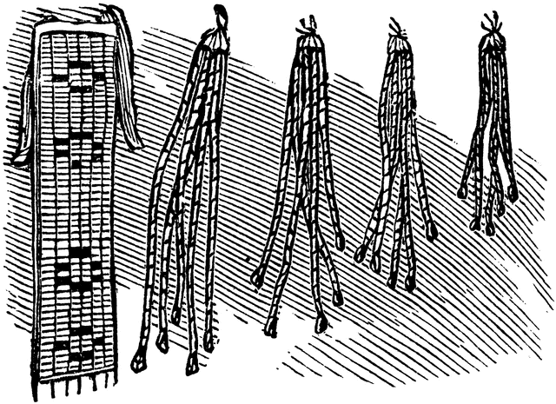
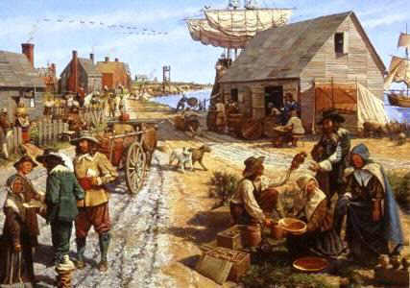
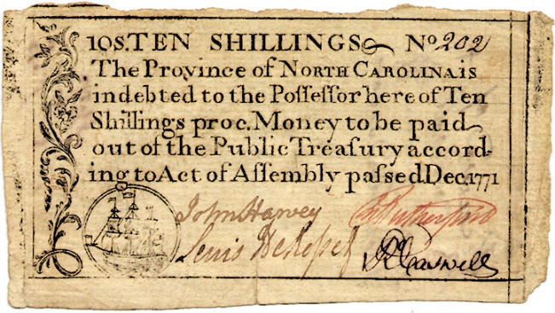
The colonies out of necessity became a public money laboratory and prospered.

Slide 27
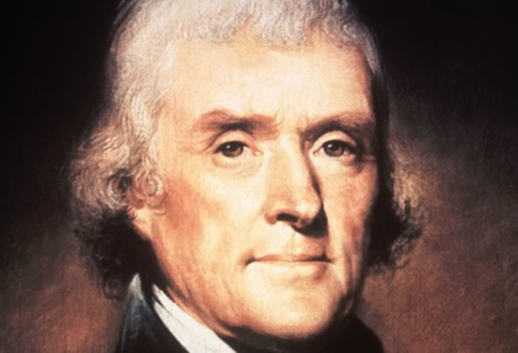
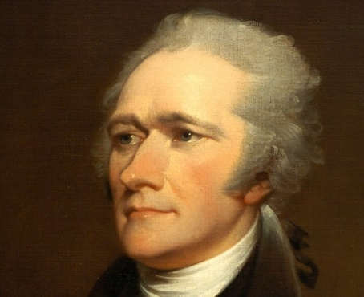
MONEY
DEBT
THE
POWER STRUGGLE
FARMER
BANKER
"The issuing power should be taken from the banks and restored to the people, to whom it properly belongs."
“The United States debt, foreign and domestic, was the price of liberty.”

Slide 28
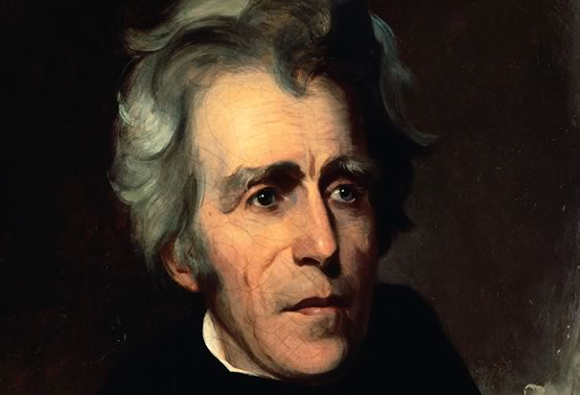
Andrew Jackson 1767 1849
Assassination attempted
“If congress has the right under the Constitution to issue paper money, it was given them to use themselves, not to be delegated to individuals or corporations.”

Slide 29
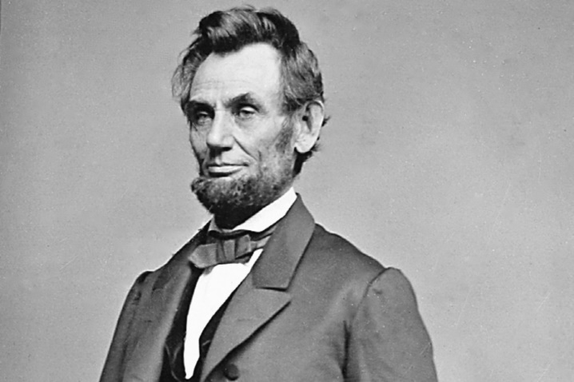
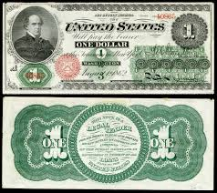
“I have two great enemies, the Southern Army in front of me and the bankers in the rear. Of the two, the one at my rear is my greatest foe.”
Abraham Lincoln 1809 – 1865
"The Government should create, issue, and circulate all the currency…
Money will cease to be master and become the servant of humanity."

Slide 30
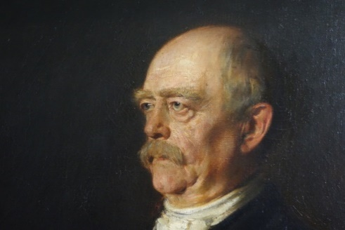
Otto von Bismark
Chancellor of Germany 1876
“These bankers were afraid that the United States, if they remained as one block and were to develop as one nation, would attain economic and financial independence, which would upset the capitalist domination of Europe over the world.“
When Lincoln got Congress to create and issue debt-free public money (Greenbacks) “…the Government and the nation escaped the plots of the foreign financiers. They understood at once, that the United States would escape their grip. The death of Lincoln was resolved upon."

Slide 31
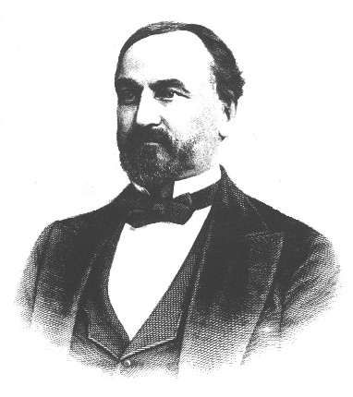
James Buel
American Bankers Association, 1877
“It is advisable to do all in your power to sustain such prominent daily and weekly newspapers, especially the Agricultural and Religious press, as will oppose the Greenback issue of paper money and that you will also withhold patronage from all applicants (for loans) who are not willing to oppose the government issue of money. …To repel the act creating bank notes, or to restore to circulation the government issue of money will be to provide the people with money and will therefore seriously affect our individual profits as bankers and lenders. See your congressman at once and engage him to support us, that we may control legislation.”

Slide 32
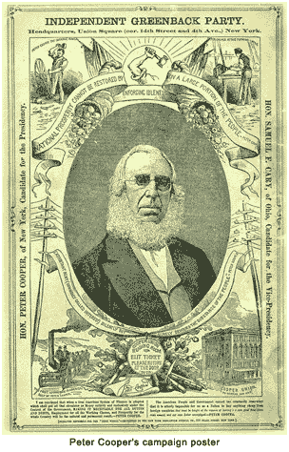
Peter Cooper - American industrialist, inventor, philanthropist, and politician. He designed and built the first American steam locomotive, the Tom Thumb, founded the Cooper Union for the Advancement of Science and Art, and served as the Greenback Party's candidate in the 1876 presidential election.

Slide 33
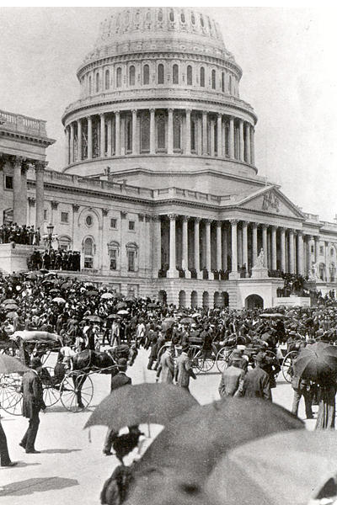
The Populist Progressive Era
“Coxey’s Army”
The primary demand was for the direct issuance of $500 million in Greenbacks to employ 4 million people to build rural roads, libraries, schools, utility plants and marketplaces and do it all debt-free!
April 30 1894

Slide 34
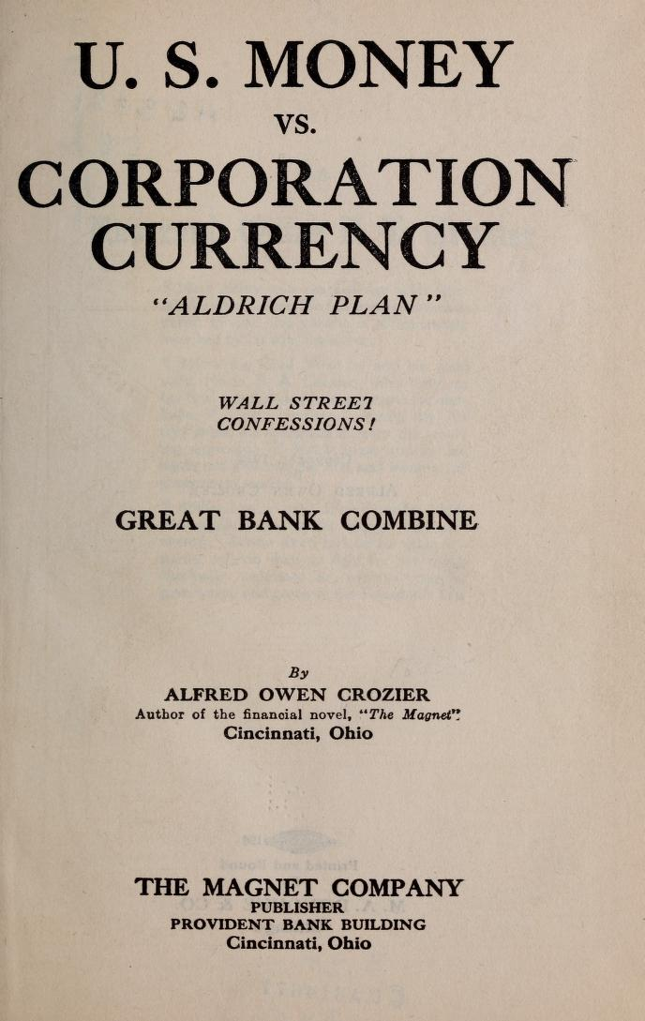
The world-around panic of the 1890s was clear evidence that the monetary issue remained but banks were backing lots of capital expansions. The number of banks more than doubled in the first decade of the new century but economic troubles continued and the bankers were bailed out. The banks offered a solution and devised the a plan to centralize their operations.
In 1912 Alfred Crozier published an expose’ of the Aldrich Plan in a book called U.S. Money vs Corporation Currency in which he described the banker’s plan to consolidate their power into a network he called The Great Bank Combine, which became the Federal Reserve, a system of usury that is provided cover by a government sounding name.

Slide 35
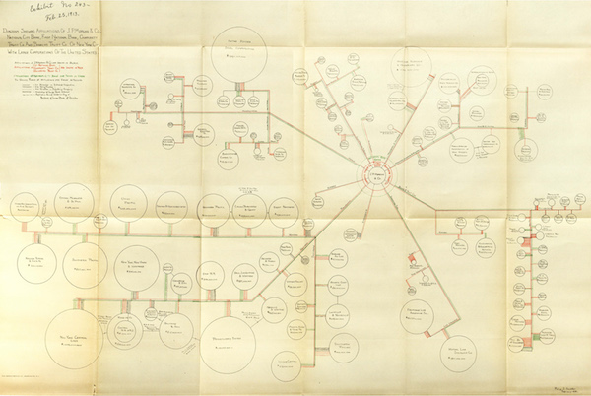
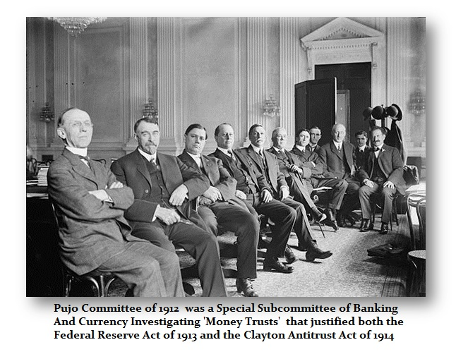
The Pujo Committee
The Committee’s report identified a financial network of elite controlled Wall Street banks linked by 341 interlocking directorships held in 112 corporations valued at more than $22 billion connected to the Morgan and Rockefeller empires. These banks exerted identifiable control over the US monetary system and economy.

Slide 36
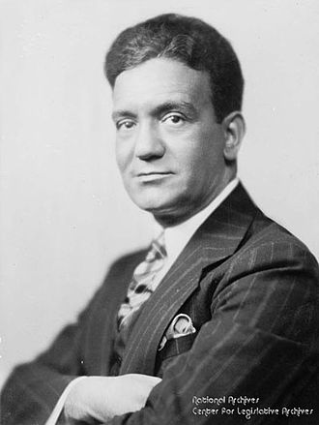
The Pecora Commission investigated the causes of the Wall Street Crash of 1929.
The Pecora Investigation uncovered a wide range of abusive practices and conflicts of interest on the part of banks and bank affiliates.
The FED’s fractional reserve system caused the great depression.
Congress passed:
Glass–Steagall to separate commercial and investment banking,
Securities Act of 1933 to set penalties for filing false information about stock offerings
Securities Exchange Act of 1934, which formed the SEC, to regulate the stock exchanges
Ferdinand Pecora

Slide 37
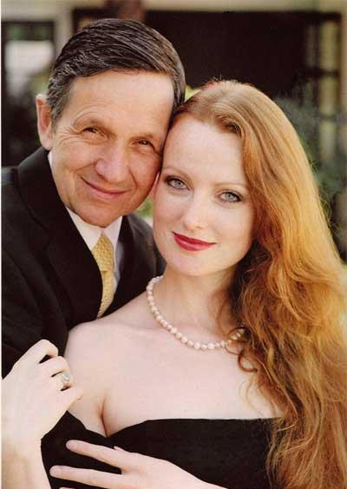
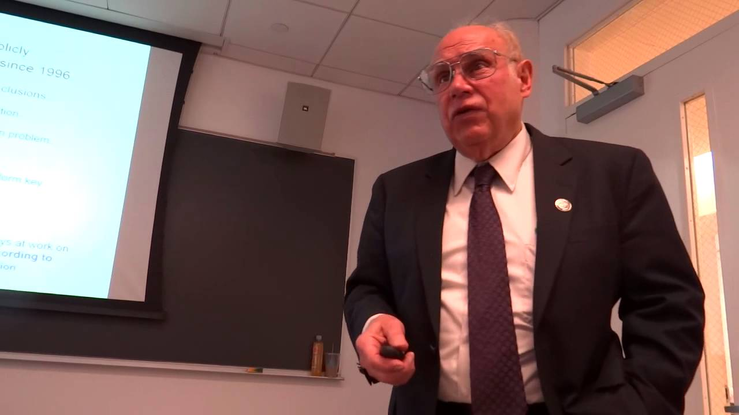
American Monetary Institute
“Money is more a question of power than economics.”
Stephen Zarlenga
Dennis and Elizabeth Kucinich
The N.E.E.D. Act ~ HR2990
The National Emergency Employment Defense Act

Slide 38
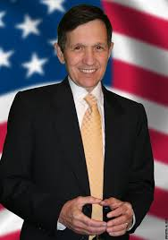
Debt-free US Notes or Greenbacks (a la Lincoln and the NEED Act – Kucinich 2011) would be better, but the NEED Act too has problems.…
It’s top-down; all money is created by a federal monetary authority. (FCV: fiscal money from Congress and Executive Branch)
It eliminates money creation by banks. But bank-created money is a good thing – if the banks are publicly owned. It’s local: bottom-up. (FCV: no fractional reserve system for both public and private banks)
The Act didn’t pass, and Kucinich wasn’t elected. (FCV: post hoc, propter hoc?)

Slide 39
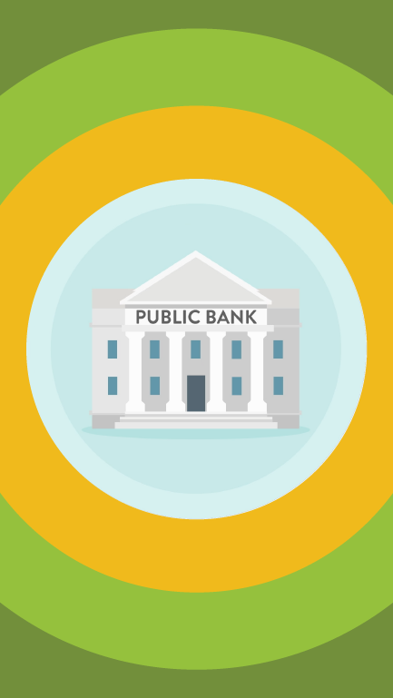
A Reset for the People
The Great Reset “gobbles up politics” by omitting democracy and individual human rights -- representation by the people for the people.
We do need a financial reset and technology and banks, but they need to serve rather than enslave the people.
How? First some financial history …

Slide 40
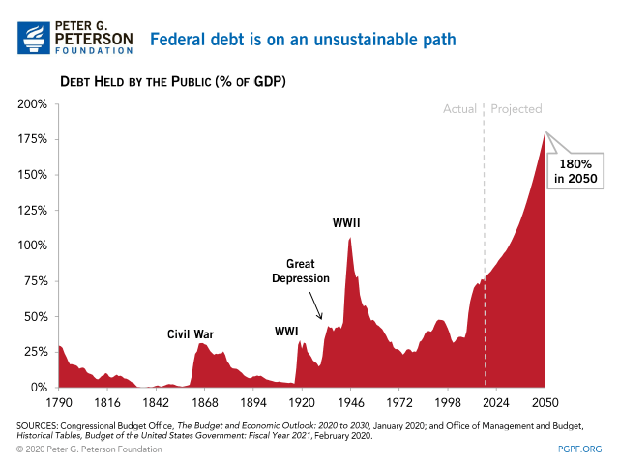
We do need a currency reset, which historically have happened after financial crises.(fcv: CURRENCY RESET IS TO BE PART OF RESETTING THE MONETARY ARCHITECTURE ITSELF)

Slide 41
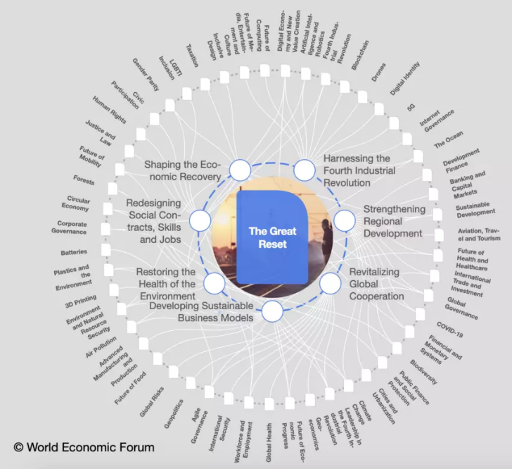
But the “Great Reset” now proposed by the World Economic Forum covers a lot more than money and debt.
The WEF is the 1% “Davos Class” of 3000 business and political leaders, founded by Klaus Schwab, a former member of the Steering Committee of the secretive Bilderberg Group linked to the New World Order.
(FCV: a real “Great Reset” implies transformation of the financial, fiscal and monetary subsystems of the world economy)

Slide 42

How financial commentators see this
“great reset”:
Dr. T. P. Wilkinson calls it the “Pharma Dollar.”
Martin Armstrong:“The Elitist Coalition to Redesign the World.”
Matt Ehret: “A system of supranational technocratic controls under a bankers’ dictatorship.”
Pepe Escobar: “A technocratic digital dystopia – digital neo-feudalism -- algorithm gobbling up politics.”

Slide 43
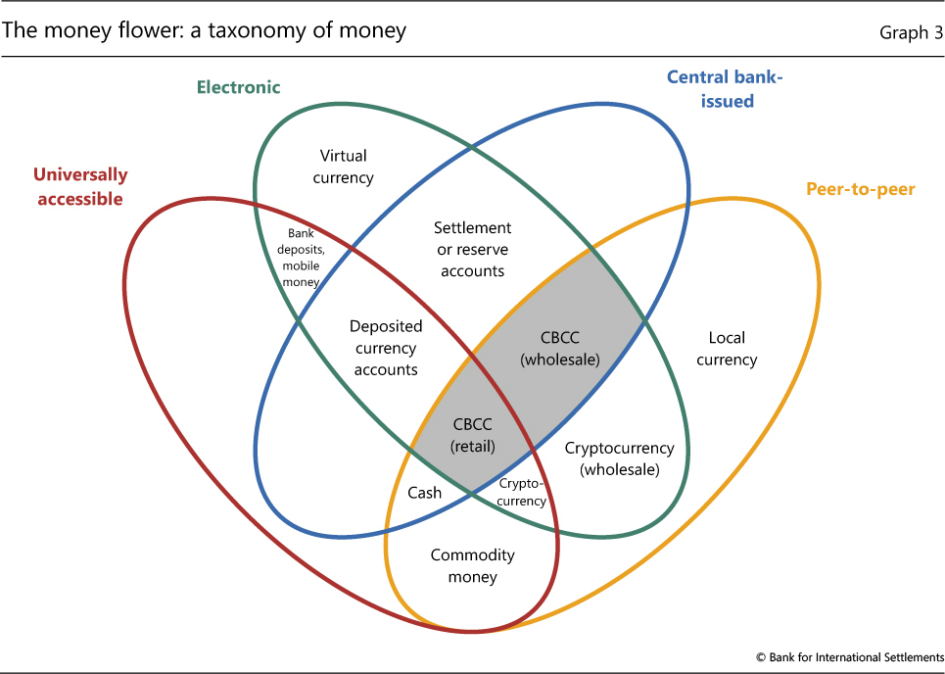
What we are more likely to get today is a central bank digital currency. But it too is top-down; not democratically controlled, and it could be controlled by global technocrats. (FCV: not within the Tierra Federated Global Sovereign Monetary Authority)

Slide 44
INTERNATIONAL DEVELOPMENT ISSUES

Slide 45
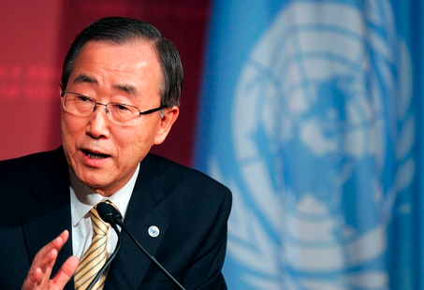
“Our foot is stuck
on the accelerator and we are heading towards an abyss.”
Ban Ki-Moon

Slide 46
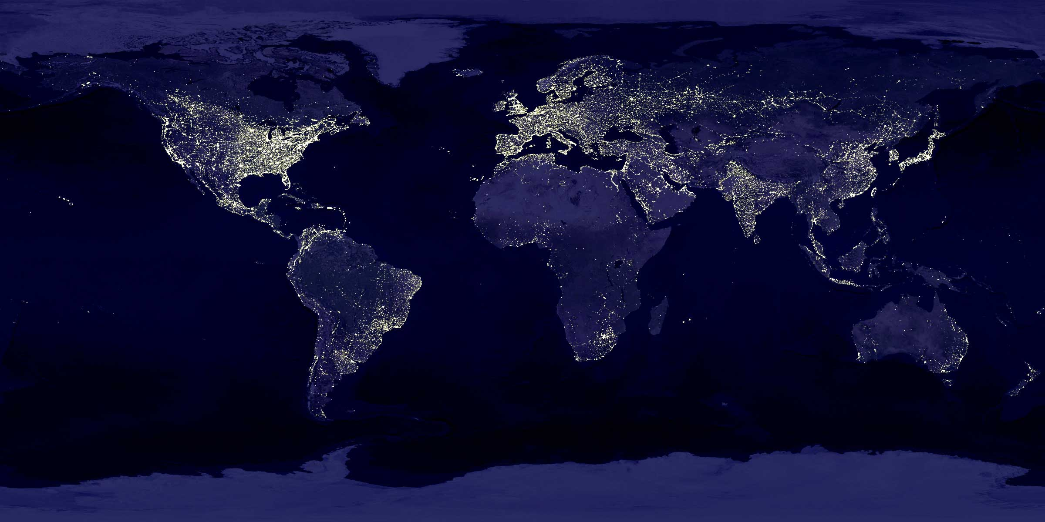
The Great Acceleration
– a planet under pressure

Slide 47
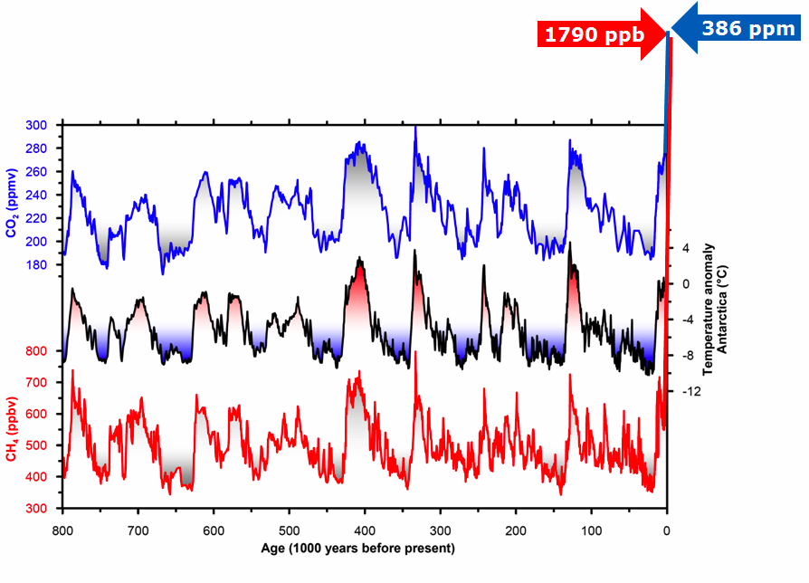
Antarctic ice core
Modern humans appear in Africa
Methane
Carbon dioxide
Carbon
dioxide
Temperature
Methane
Loulergue, L.,et al Orbittal and millennial-scale features of atmospheric CH4 over the past 800,000 years, Nature, 2008.
Lüthi, D. et al High-resolution carbon dioxide concentration record 650,000-800,000 years before present Nature, 2008.

Slide 48
Antarctic ice core
Methane
Carbon
dioxide
Beyond natural boundaries
Loulergue, L.,et al Orbittal and millennial-scale features of atmospheric CH4 over the past 800,000 years, Nature, 2008.
Lüthi, D. et al High-resolution carbon dioxide concentration record 650,000-800,000 years before present Nature, 2008.

Slide 49
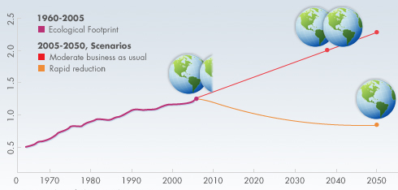
Ecological Footprint
Source: Global Footprint Network
Notes:
What does it matter if we achieve high levels of human development if, in the process of doing so, we trash the ecological systems upon which all natural and human systems depend? Ecological footprint addresses this question. It measures how much land and water area a human population requires to produce the resources it consumes and to absorb its wastes under prevailing technology. This graph shows that footprint has been increasing right along with GDP. Ecological footprint tells us about the biological and physical costs of growing the economy in a single statistic. The Y-axis on the graph shows biological capacity measured in Planet Earths. In the mid to late 1980s, the global ecological footprint surpassed the capacity of the planet.
Having a footprint beyond the capacity of the planet means we are using resources faster than they can be regenerated. It means that we are accumulating ecological debt. The problem with that kind of debt is it’s not so easy for the federal government to step in and bail us out.
10 Smallest E.F. per person in 2008: Malawi, Afghanistan, Haiti, Congo, Bangladesh, Dem. Rep. of Congo, Tajikistan, Swaziland, Nepal, Zambia
10 Biggest: United Arab Emirates, USA, Kuwait, Denmark, Australia, New Zealand, Canada, Norway, Estonia, Ireland.
The top and bottom 10 are somewhat of a reversal of the HDI.

Slide 50
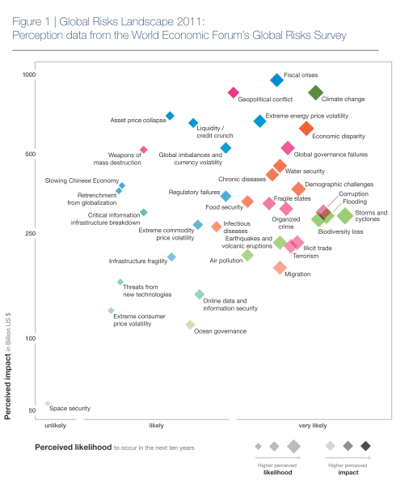

Slide 51
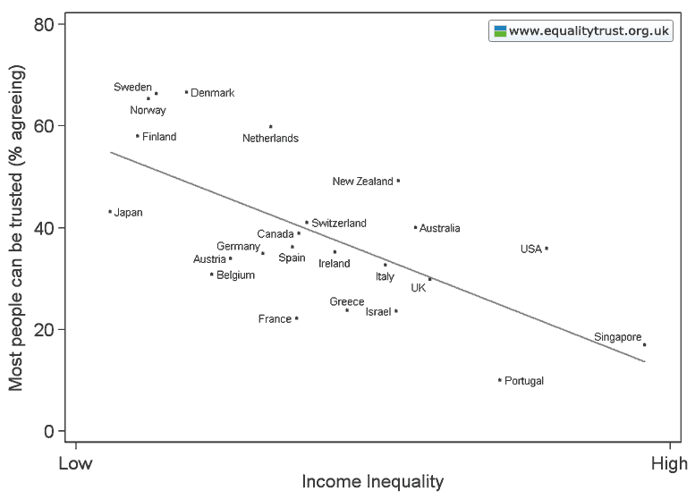

Slide 52
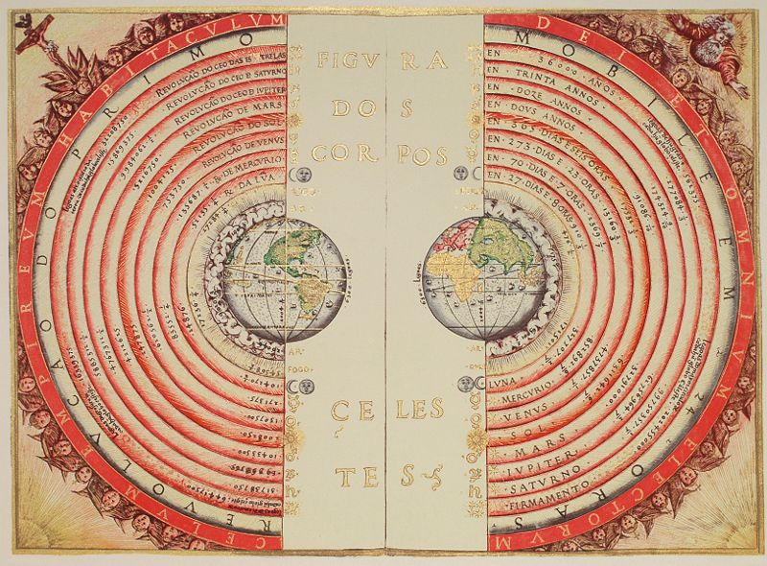
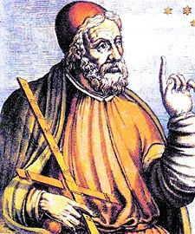
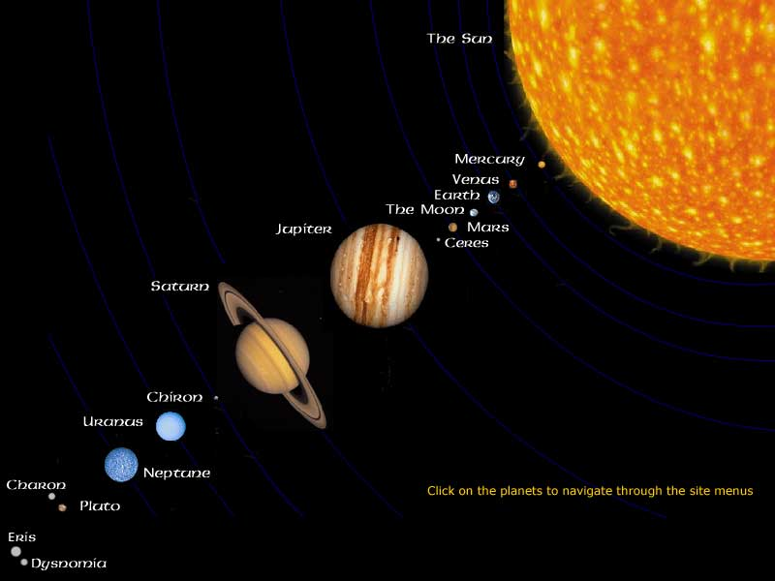
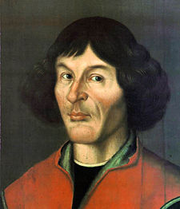
Changing the Paradigm
Notes:
It is time for the paradigm of growth to change. It is difficult, if not impossible, to measure and pursue quality of life if we are obsessed with increasing the size of the economy. At CASSE, we have crafted a position on economic growth to start the paradigm shift. We are trying to help the public understand the conflicts between growth and other societal goals.
We propose an economy with stable population and consumption so that we can focus on development rather growth – better lives rather than more stuff.
Supporting the CASSE position and other efforts to recognize the true nature of economic growth is critical.

Slide 53
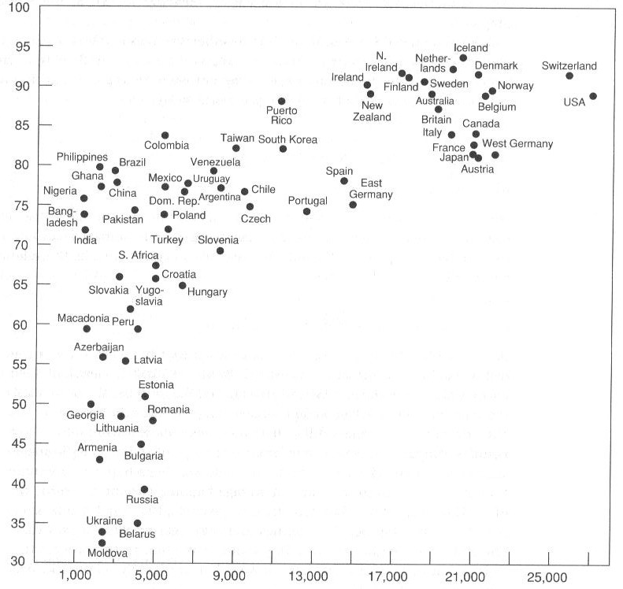
GDP and Happiness
Happiness
Index
Source: Inglehart and
Klingemann(2000)
Income per Person ($)
Notes:
The study of happiness in the fields of economics and psychology is gaining traction. This is a graphical depiction of the relationship between happiness and income. The X-axis is income per person, and the Y-axis is an index of self-reported happiness. The dots represent countries. So each country takes its spot on the graph based on how much money people receive and how happy they are on average.
There seems to be a fairly clear relationship between income and happiness. Nations with high incomes tend to be happier. But the relationship starts to break down once a certain income threshold is surpassed. Once people can meet their needs and achieve some level of comfortable living standards, more income appears not to make them happier.

Slide 54
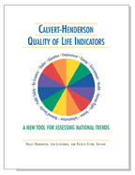





Calvert-Henderson Indicators
Education
Employment
Energy
Environment
Health
Human Rights
Income
Infrastructure
National Security
Public Safety
Recreation
Shelter
Notes:
Quality of life is difficult to measure. Maybe it requires more than a single indicator. Created by the Calvert Group (an investment fund that helped pioneer socially responsible investing) and economic activist Hazel Henderson, the Calvert-Henderson Quality of Life Indicators provide comprehensive statistics of national wellbeing that go beyond traditional macroeconomic indicators. A systems approach is used to illustrate the dynamic state of our social, economic and environmental quality of life. The dimensions of life examined include: education, employment, energy, environment, health, human rights, income, infrastructure, national security, public safety, recreation and shelter.

Slide 55

What is Quality of Life?
Perception
Human Needs Soup
Ingredients:
Subsistence, Reproduction,
Security, Affection, Leisure,
Understanding, Participation,
Spirituality, Creativity,
Identity, Freedom
Opportunity
Natural Capital
Social Capital
Human Capital
Built Capital
Notes:
Before considering indicators of quality of life or wellbeing, it’s a good idea to define it. Quality of life is a bit harder to define than it would seem. We could define it simply as happiness, but that doesn’t help us figure out a way to measure it. Robert Costanza and his colleagues have come up with a technical, but intriguing definition. Quality of life is the extent to which objective human needs are fulfilled in relation to perceptions of subjective wellbeing.
Think of a can of soup – human needs soup. Every human has a can of basic needs. These needs are subsistence, reproduction, security, affection, leisure, etc. The importance and size of each need differ from person to person, but we all have needs. To improve QOL, we need opportunities to fulfill those needs. We need a can opener, which represents the 4 different types of capital in the world – natural capital (the structure of natural ecosystems), social capital (networks and norms that facilitate cooperative action), human capital (knowledge and labor potential), and built capital (manufactured goods, buildings, tools, and infrastructure). More opportunity to fulfill needs using these forms of capital results in higher QOL. But there’s another piece of it – and that’s our subjective perception of the degree to which our needs are met. Just because we have opportunities and even if we take advantage of them, we still have to feel like our needs are being met.
Measuring such quantities is admittedly difficult, but there have been some solid attempts to do just that.

Slide 56
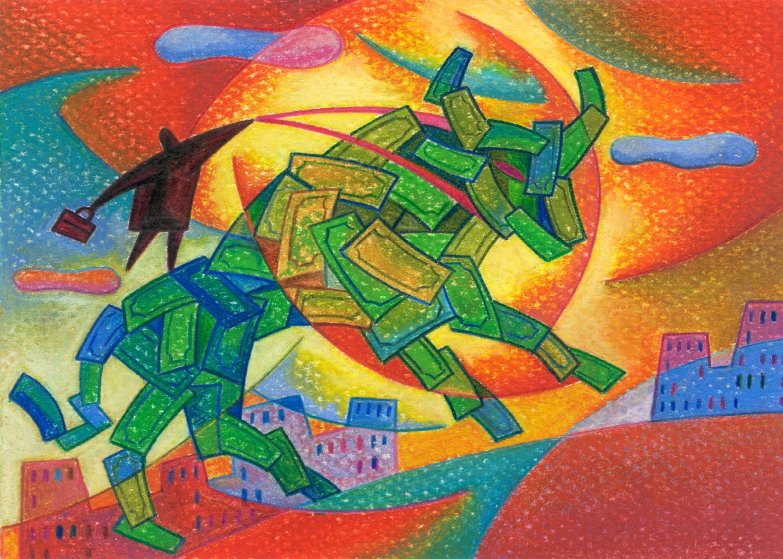
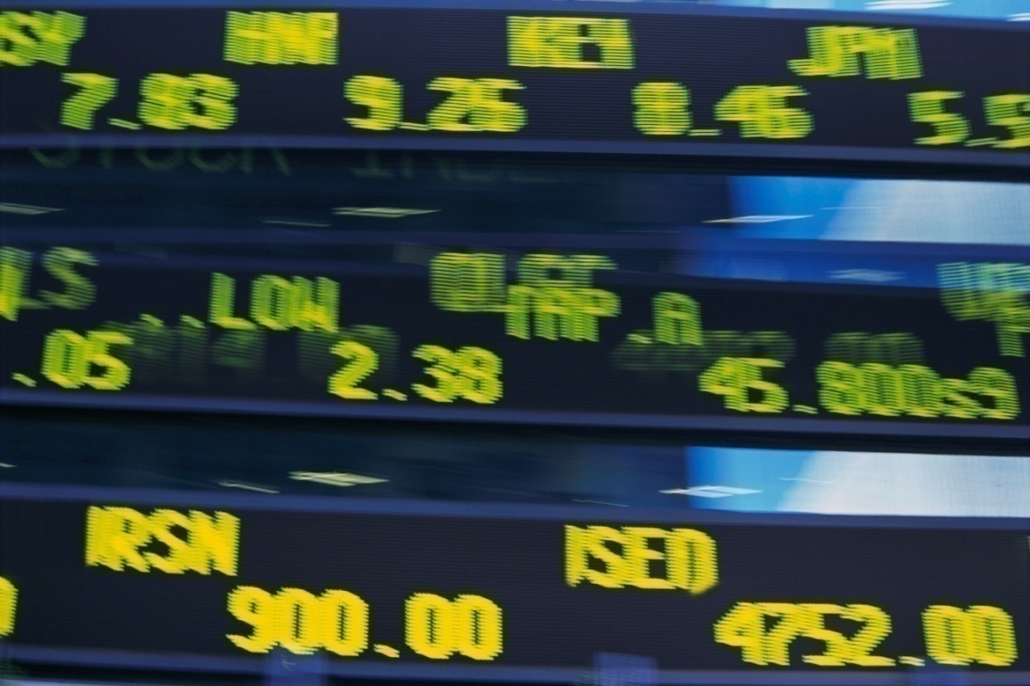
What Is Economic Growth?
Notes:
Economic growth is an increase in the production and consumption of goods and services. Economic growth means that the economy is getting bigger, not necessarily better.
Economic growth is a means to an end, and not an end in itself. True economic ends are things like long and happy lives, healthy ecosystems, vibrant communities, and opportunities for meaningful employment. Economic growth is NOT the same as economic development.
An interesting point about this graphic: Increasing GDP doesn’t mean that the increase is distributed fairly amongst citizens. Now there are lots of things to decide when it comes to defining fairness, but distribution is usually quite lopsided. The picture of one lonely guy riding the bull of economic growth into the sunset is pretty accurate.

Slide 57
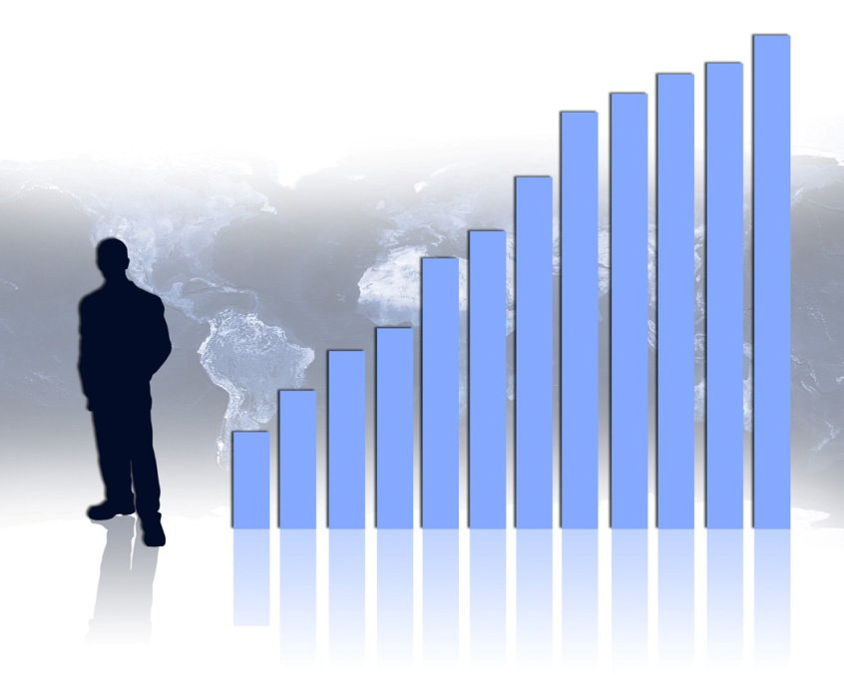
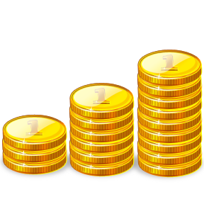
Paradigm of Growth
Notes:
A second barrier is the growth imperative itself. Economists, politicians, businesses – they seem to be obsessed with growth. They appear to be much more concerned with getting bigger instead of getting better. Unfortunately, growth has been confused with development, and it has become the accepted paradigm for our economy. As a simple illustration all these graphics and more came from the clip art in Powerpoint when I typed in the word “economy.” An economy that is getting bigger is generally deemed to be a healthy economy.
Given that perception, people will have a difficult time letting go of GDP as the measure of progress.

Slide 58
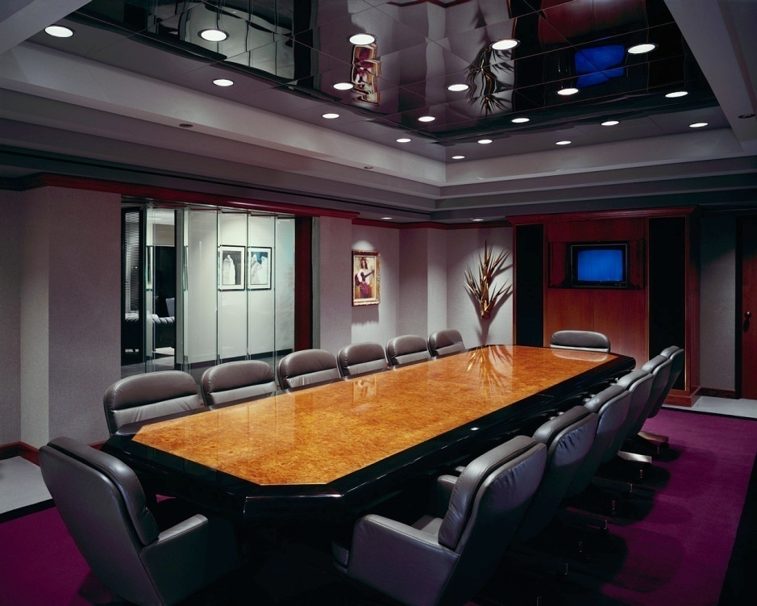
Powerful Interests
Notes:
The third barrier is formed by the collection of powerful interests that have a stake in the economic system as currently configured. From big corporations to university departments to media pundits, there are influential people who benefit greatly from a system that aims for ever-increasing GDP growth.

Slide 59
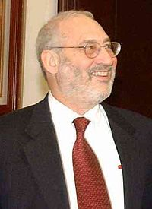
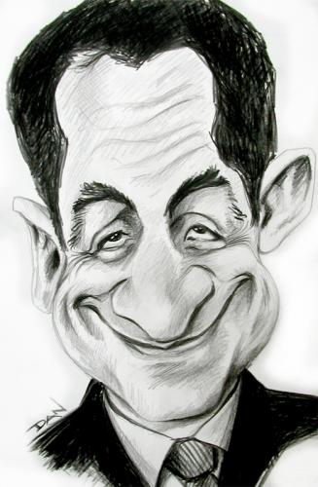
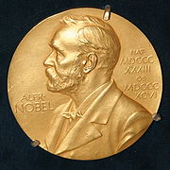
Stiglitz Commission
Notes:
French President Nicolas Sarkozy launched the Commission on the Measurement of Economic Performance and Social Progress in 2008. It is chaired by Joseph Stiglitz and includes four other Nobel laureates -- Kenneth Arrow, James Heckman, Daniel Kahneman, and Amartya Sen.
Stiglitz has written, “Developing measures that truly capture progress is a subject close to my heart and indeed is the focus of the Commission.”
The Commission has embarked on three areas of enquiry for measuring progress:
How GDP might be extended or modified;
Sustainable development and the environment, and how economic performance and social progress relate to them;
Quality of life, including metrics to find out how people actually feel about their lives and their own wellbeing.

Slide 60

A safe operating space for humanity
Ozone
Depletion
Climate Change
Atmospheric Aerosol Loading
Nitrogen
Ocean
Acidification
Phosphorus
Rate of Biodiversity Loss
Global
Freshwater Use
Land System Change
Chemical
Pollution
Rockström et al. 2009
Notes:
Beyond climate

Slide 61
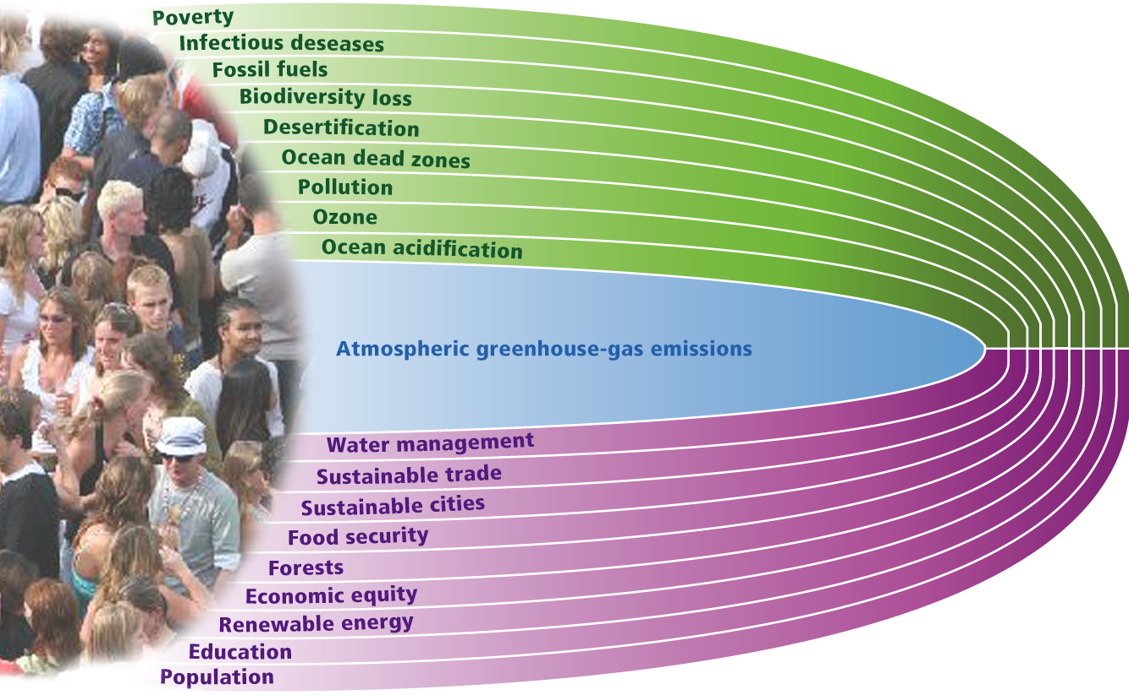
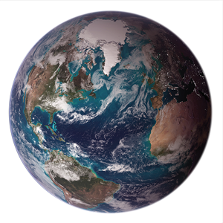
Planetary Stewardship
2020
2030
2040
2050

Slide 62
Any additional questions?

